Slide 1


Impact of Science Conference the Parallel Session on:
Developing a Regional or National Impact Policy
23rd June, 2021

Slide 2
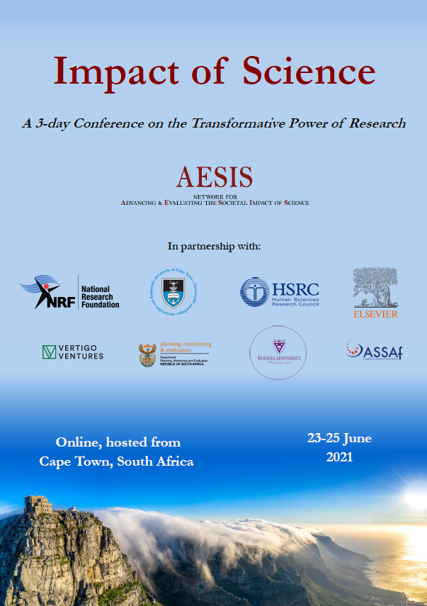

Impact of Science
23-25 June, 2021
Overview of the Speakers
Mahama Ouedraogo (Chair): Executive Director of Education, Science, Technology Innovation in African Union, Ethiopia
Tateo Arimoto: Deputy Director General, Center for Research and Development Strategy (CRDS), Japan Science and Technology Agency (JST), Japan
Sarah Foxen : Knowledge Exchange Lead at POST, UK Parliament, United Kingdom
#IOS21

Slide 3
Impact of Science
23-25 June, 2021
Tateo Arimoto
Deputy Director General, Center for Research and Development Strategy (CRDS), Japan Science and Technology Agency (JST), Japan
#IOS21

Slide 4
“Developing a Regional or National impact Policy
for SDGs and the Pandemics ”
Impact of Science, Conference on the Transformative Power of Research, AESIS, Cape Town, 23-25 2021
23 June 2021, Tateo ARIMOTO Visiting Professor, STI Program,
National Graduate Institute for Policy Studies（GRIPS), Principal Fellow of Japan Science & Technology Agency(JST) and Vice Director of International Institute for Advanced Studies

Slide 5
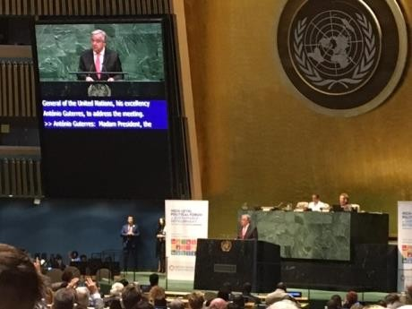
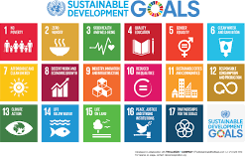
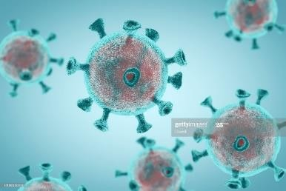
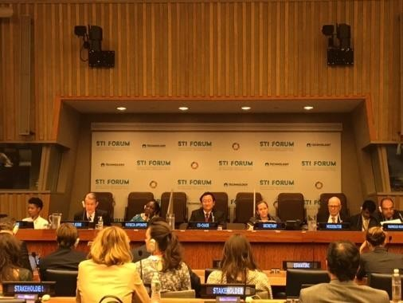
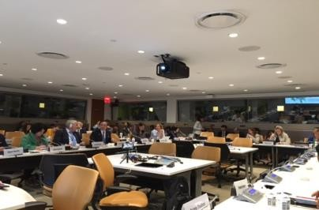
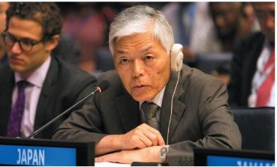
Resolution by the UN General Assembly, September 2015
” Transforming our world: the 2030 Agenda for Sustainable Development ”
United Nations Multi- stakeholder Forum on STI for SDGs
Sustainable Development Goals (SDG)
Goal 1. End poverty in all its forms everywhere
Goal 2. End hunger, achieve food security and improved nutrition and promote sustainable agriculture
Goal 3. Ensure healthy lives and promote well-being for all at all ages
Goal 4. Ensure inclusive and equitable quality education and promote lifelong learning opportunities for all
Goal 5. Achieve gender equality and empower all women and girls
Goal 6. Ensure availability and sustainable management of water and sanitation for all
STI for SDGs & the Pandemics, and they are giving us great opportunities to reform STI values and systems

Slide 6
Goal 7. Ensure access to affordable, reliable, sustainable and modern energy for all
Goal 8. Promote sustained, inclusive and sustainable economic growth, full and productive employment and decent work for all
Goal 9. Build resilient infrastructure, promote inclusive and sustainable
industrialization and foster innovation
Goal 10. Reduce inequality within and among countries
Goal 11. Make cities and human settlements inclusive, safe, resilient and sustainable Goal 12. Ensure sustainable consumption and production patterns
Goal 13. Take urgent action to combat climate change and its impacts*
Goal 14. Conserve and sustainably use the oceans, seas and marine resources for sustainable development
Goal 15. Protect, restore and promote sustainable use of terrestrial ecosystems, sustainably manage forests, combat desertification, and halt and reverse land degradation and halt biodiversity loss
Goal 16. Promote peaceful and inclusive societies for sustainable development, provide access to justice for all and build effective, accountable and inclusive institutions at all levels
Goal 17. Strengthen the means of implementation and revitalize the Global Partnership for Sustainable Development

Slide 7

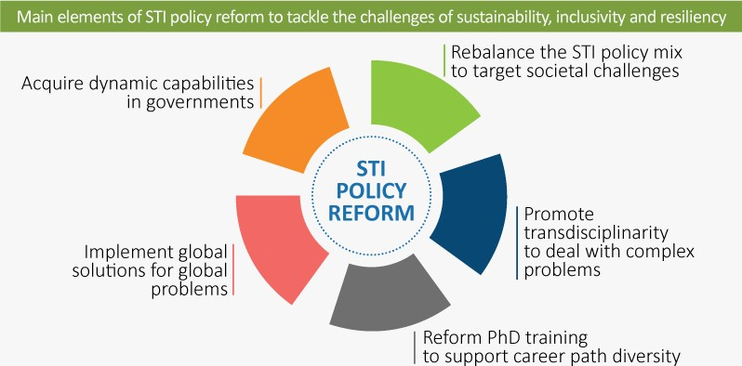
2
1
“OECD Science, Technology and Innovation Outlook 2021 – Times of Crisis and Opportunity-”, February 2021
3
4
5

Slide 8
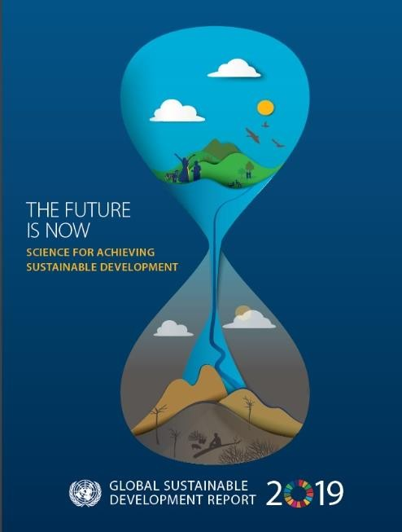
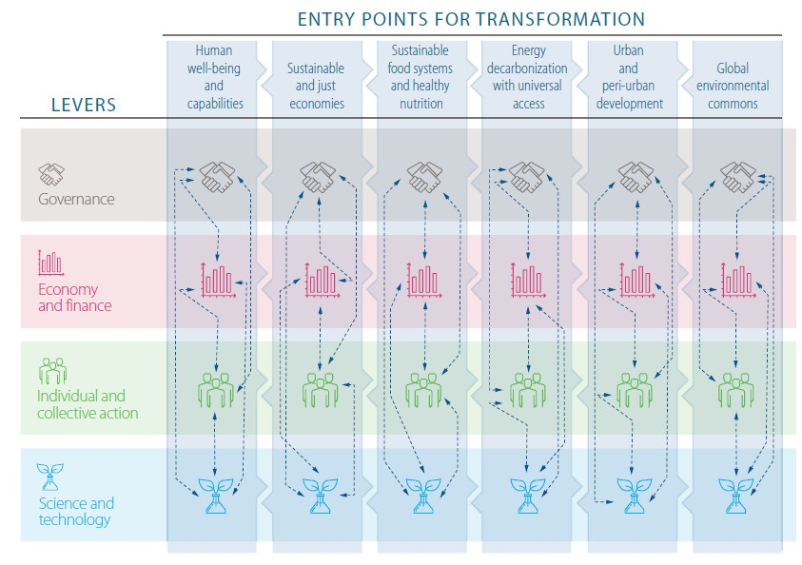
UN recommends “4 levers” and
“6 Entry Points for Social & Economic Transformation”
人間生活の _{持続可能で} 持続可能な ^{エネル} 持続可 ^{世界的な} 質と能力の _{正当な経済} 食料システ ^{ギーの脱} 能な都 ^{環境共有} 向上 ムと健康的 ^{炭素化と} 市と周 ^{空間の確}
_{栄養} エネル _{辺部の} ^{保}
ギーへの _{実現} 悉皆的な
ガバナンス ^{アクセス}
経済と
ファイナンス
個人と集団 としての行動
科学技術
UN Global Sustainable Development Report (GSDR）2019
1 2
Scale: Global - Regional - National - Local/subnational
3
4
5
Lacking important items for SDGs: ①military conflicts ②stock farmer ,
③Spiritual values , ④Culture, ⑤drug ⑥animal welfare, ⑦gene editing

Slide 9
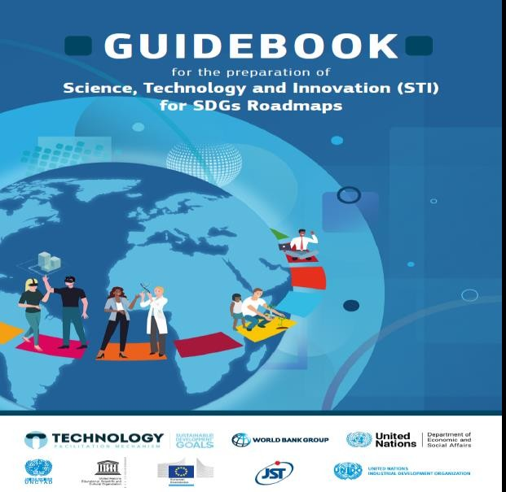
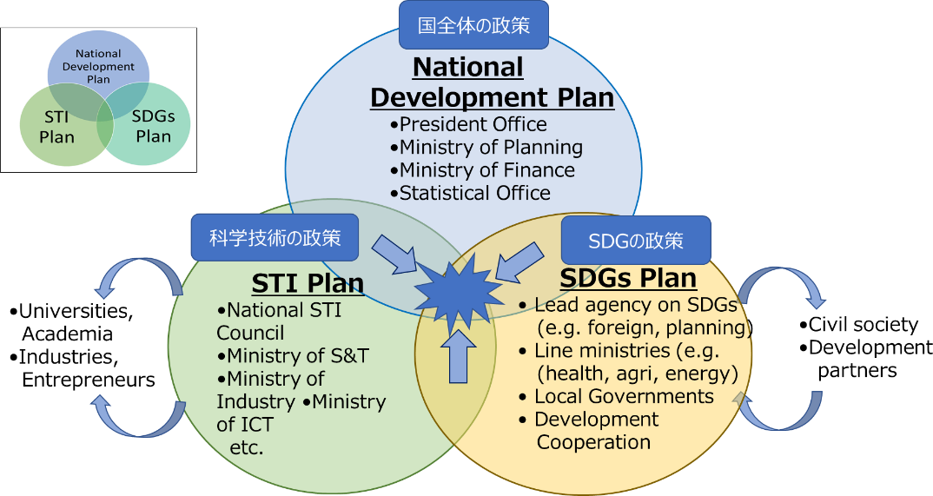
Bridging national development policy, STI policy and SDG policy
~ STI for SDGs roadmaps ~
National Policy
STI Policy
SDGs Policy
6
https://sustainabledevelopment.un.org/content/documents/227246Guidebook_STI_for_SDG_Roadmaps_Draft_for_STI_Forum.pdf

Slide 10




STI for SDGs Roadmaps
for collaborating with multi-stakeholders, formulating the action plans to achieve SDGs, and tracking the progress
The UN Inter-Agency Task Team G20 Development Working Group (DWG)
⚫ Expert Group Meeting on STI for ⚫ Compiling “Guiding Principles for the
SDGs Roadmaps (NY, Tokyo, Brussels and Nairobi)
Development of Science, Technology, and
Innovation for SDGs Roadmaps”
⚫ Guidebook for the Preparation of
of STI for SDGs Roadmaps
One of the outcome document in G20 OSAKA SUMMIT (2019.6)
⚫ UN-IATT launched the “Global
Pilot Program on STI for SDGs Roadmaps” and selected the following countries for the Pilot
Japan’s NEXT STEP
Formulate STI for SDGs roadmap for major
issues in Japan and review them every year;
scale: national and local
Supporting the pilot countries and other developing countries in formulating STI for SDGs roadmaps and concrete implementation.
Program.(2019.7)
STI for SDGs Roadmap Pilot countries : Ethiopia, Ghana, India, Kenya, and Serbia
Partner Countries :
The European Union and Japan
(Policy making, thematic themes, thinktank, Capacity building)
7

Slide 11
Basic Law (1995）
Science and Technology
Purpose
Science, Technology and Innovation Basic Law (2020）
Improving the level of science and technology
Creating innovation（new）
Promoting humanities and
social sciences（new）
Three main objectives
6th STI Basic Plan (2021～2025)
Transformation into a sustainable and resilient society that ensures the safety and security of its citizens (new)
Strengthen research capabilities to explore the frontiers of knowledge and become a source of value creation
Education and human resource development to realize well-being in society and individual diverse happiness (new)
Japan’s STI Basic Law System changed, 2020-2021～

Slide 12
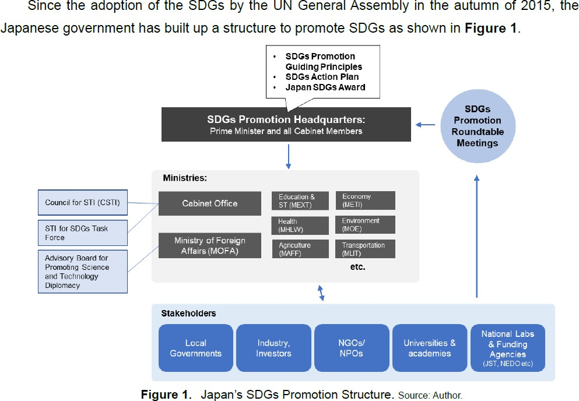

Slide 13
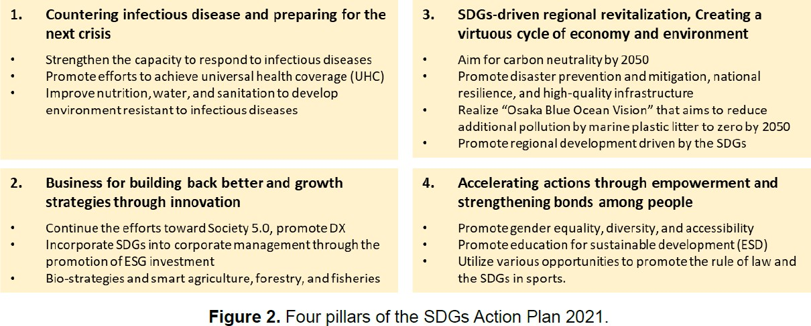

Slide 14
STI for SDGs Roadmaps
A tool to help multi-stakeholders work together to develop and implement action plans and monitor progress toward achieving the SDGs.
Promotion
Global Level
Themes； Climate Change COVID-19
Digital Cooperation
etc.
National Level
National prosperity and welfare, programs, activity plans, progress monitoring
Alignment of policy and implementa tion; funding, regulation, investment, human resources, taxation, etc.
Local Level
Regional sustainable & resilient development. action plans.
monitor & evaluate
Global challenges, Participation of all member countries
Themes；
AI、Food、Energy、 Smart City、Aging、 Disaster prevention, etc.
Business/operational roadmaps partnerships, pre-competitive phase policy
Organization Level
Action
11

Slide 15
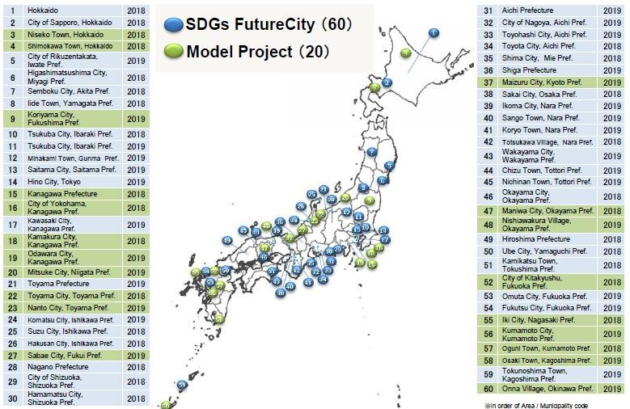

SDGs Future Cities in Japan since 2019 - Boosting SDGs in local level
Localization of SDGs
Selection criteria : Universality,
Inclusiveness, Participation, Integration, Transparency & Accountability
Sharing cases & experiences; Customization &
Commonization
Source (Dr. Murakami’s presentation): http://future-city.jp/data/pdf/eve
nt/2020/20200110_Shuzo_Murakami_en.pdf

Slide 16
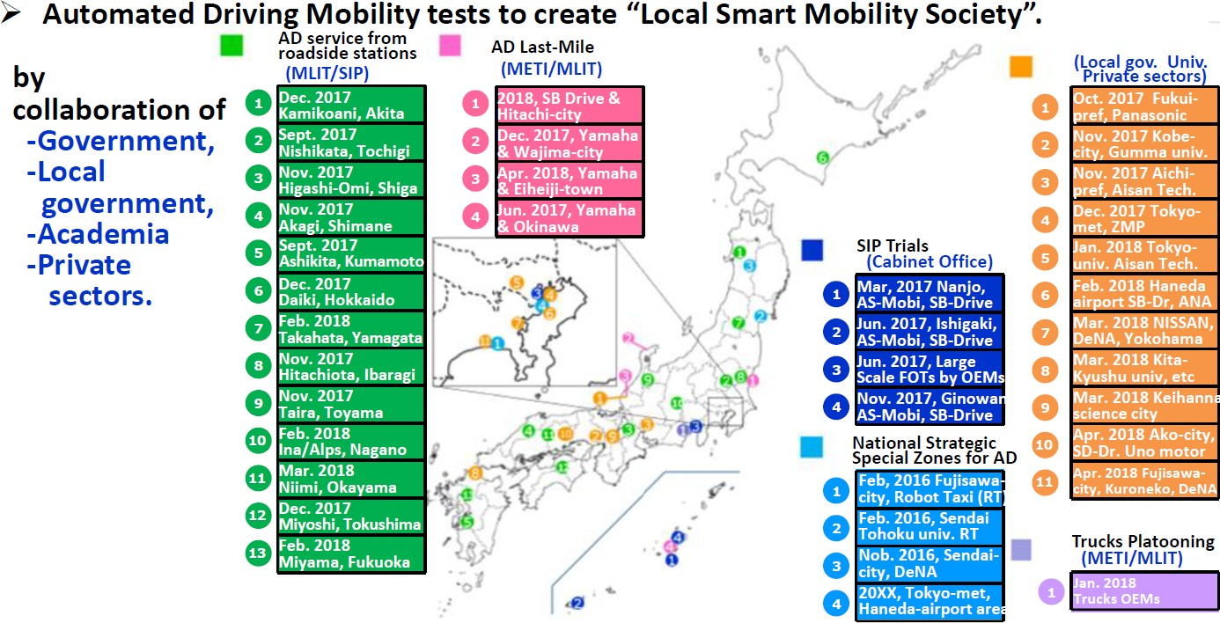
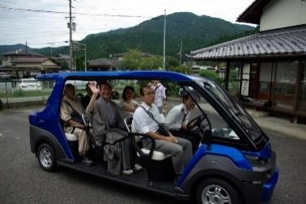
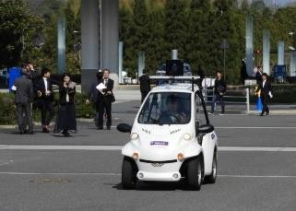
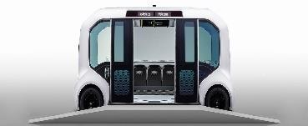
Automated Driving System Field Operational Tests across Japan
13

Slide 17
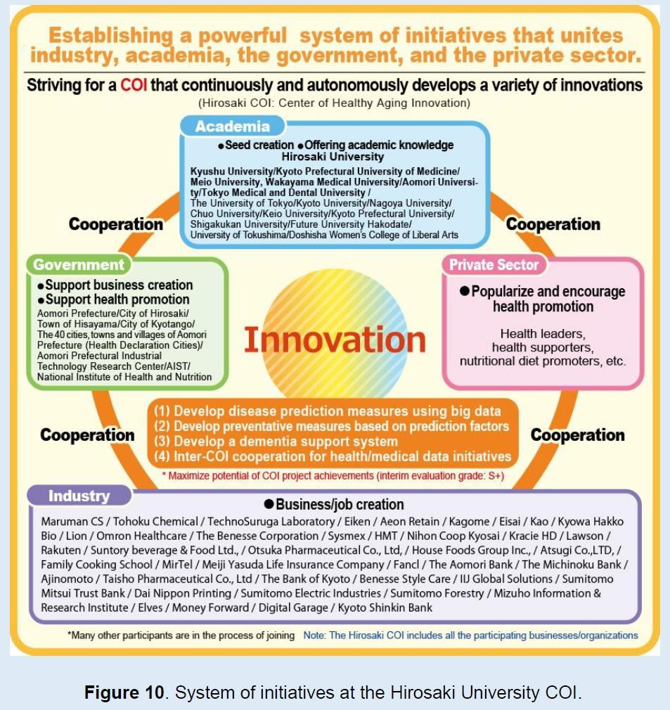





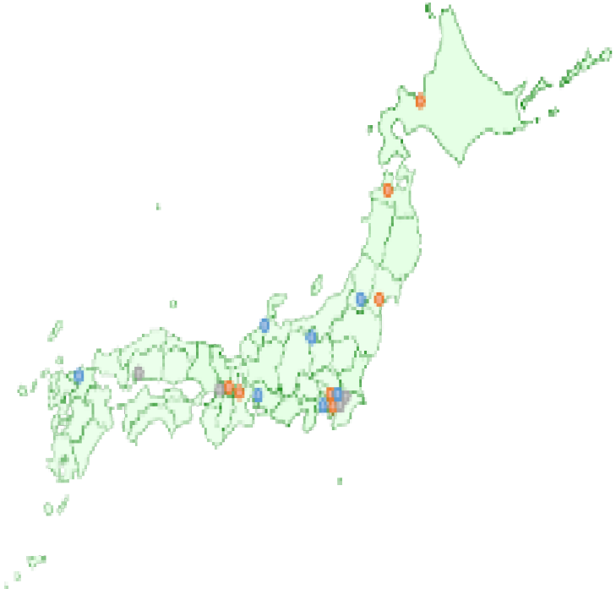

Local SDGs
Hirosaki University,
Medical examination field
（big data)
University-led PPPs for Co-creating Values
- From Redeeming
the “Lowest Life
Expectancy Pref.”
Kagome
Eisai Lion
Suntory
- to Promoting Health across
Japan &
- the World -
Kyowa Hakko Bio
Kao

Slide 18
Addressing Societal Challenges using Transdisciplinary Research by OECD
3
Transdisciplinary research(TDR) is important for developing solutions to complex societal challenges, including the SDGs. Key features of transdisciplinary research:
Collaboration between natural and social sciences/humanities
Engagement of non-academic stakeholders, such as public officials, citizens and commercial or not-for-profit organisations
Aim : How do we promote transdisciplinary research (TDR) at the project level across different communities and countries to address complex societal challenges? The project:
Focuses on a systematic analysis of practices and challenges for transdisciplinary research
Case study survey and interviews to clarify the key aspects of successful transdisciplinary research
Aims to promote mutual learning between countries, through sharing of good practices
Participating countries: BEL, CHE, COL, DEU, FRA, JPN, KOR, NLD, NOR, UK, USA
Co-Chairs: Tateo Arimoto (JPN), Jakob Zinsstag (CHE),
Two workshops(Paris and Tokyo), ITConference (Sweden) and Belmont Forum (WDC)

Slide 19
OECD TDR projects : 28 Case studies
Lead Country | Subject Areas | Cases
Belgium | Food, land use, environment | 3
Colombia | Traditional music | 1
France | Climate change, transport, atmospheric pollution and health | 2
Germany | Solar energy-food nexus, water resource management, agriculture | 3
Japan | Natural disasters, energy, bio resources and disaster, mobility and ageing | 3
Korea | Community policing | 1
Netherlands | Water and health, CO2 emissions, energy | 3
Norway | Climate change, risk governance, sustainable fish industry, Public health | 4
Switzerland | Public health, water management, urban planning | 3
UK | Pig industry, solar energy | 2
USA | Water resource, energy, health technology | 3

Slide 20
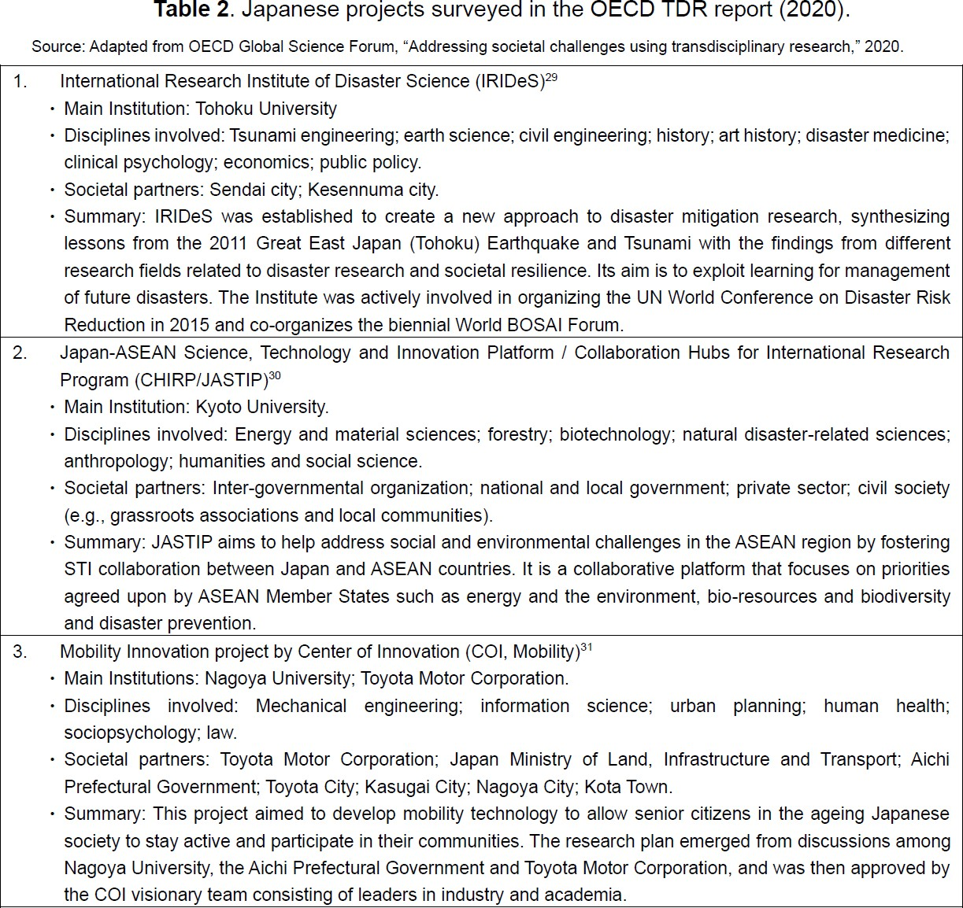

Slide 21
OECD Report, Recommendations to governments, funding agencies, universities, academies and private sectors to promote TDR for societal challenges
Governments
Governments need to recognise and promote transdisciplinary research, as an essential complement to other more traditional research approaches, in addressing complex societal challenges e.g.SDGs. Governments have a critical role to play in establishing the overall framework that enables and supports effective TDR, and Promoting cooperation across ministries and public authorities for TDR .
Research funding agencies
Research funding agencies have a critical role to play by directly supporting and incentivising TDR research. This affects both prioritisation of research areas and changes to funding processes, including funding criteria, peer review and evaluation. Provide long-term funding for TDR to address societal challenges, e.g. challenge-based funding, at local, national and international scales. experimentation with different mechanisms. Extension of funding , and/or collaboration with other donors. Support capacity building.

Slide 22
Universities and Public Research Institutions
Universities and PRIs are the principle organisations through which TDR is carried out and their long- term strategic commitment and support is essential if TDR is to be expanded to the scale that is necessary to address complex societal challenges. This has implications for education and training, as well as research. It also cuts across the so-called 3rd mission activities (societal engagement and innovation) of universities and PRIs.
The academic community and science associations
The academic community has a major influence on science policy development and the definition of research strategies and priorities. It is responsible for conducting peer review and evaluation processes and often has a strong voice in how these are designed and conducted. Universities and PRIs tend to have considerable autonomy and are rightly responsive to their academic employees. Thus, whilst policy- makers and other actors can provide mandates and incentives for TDR, their impact will be limited without the support of the academic community and its representative associations. contributing to the development of new STI indicators and measures that value the combination of multiple research outputs.

Slide 23




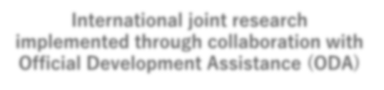





















SATREPS
( Science and Technology Research Partnership for Sustainable Development)
4
Aims
□Environment and Energy
□Disaster Prevention and Mitigation
□Bioresource Utilization
□Infectious Diseases Cont*r^{A}o^{M}l^{ED}
Enhancing Cooperation in Science & Technology
Building win-win relationships between
Japan and developing countries
New Technology, New Knowledge, Innovations
Addressing global issues and advancing science
Capacity Development
Boosting self-reliant R&D capacity and sustainable research systems, training human resources and coordinating networking between researchers
International joint research implemented through collaboration with Official Development Assistance (ODA)
MEXT, JST/AMED
MOFA,
JICA
collaboration
60M JPY/
project/year
Competitive Fund
Technical Cooperation
35M JPY/
project/year
Japan
Research Institutions
International Joint Research
Counterpart Country
Research Institutions
Practical Utilization & Implementation of Research Outcomes for the Society
Research Partnership
3-5 years
145 projects in 51 countries from 2008 to 2019

Slide 24
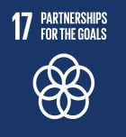
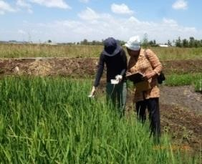


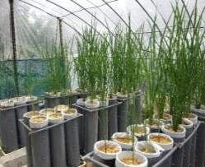









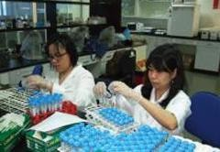


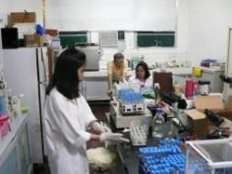
Examples of Outcomes
Creating Rice Varieties and Cultivation Technology
Tailor-made for Kenya's Environment
【Environment and Energy (Global‐scale Environmental Issues)】
Adoption FY 2012 Kenya project
‘Rice Research for Tailor-made Breeding and Cultivation Technology Development in Kenya’
Standing Up to Earthquakes and Tsunamis: Joining Hands with Peru across the Pacific
【Disaster Prevention and Mitigation】
Sumitomo Chemical
Long-lasting insecticidal mosquito net (Olyset™ Net)
Adoption FY 2009 Peru project
‘Enhancement of Earthquake and Tsunami Disaster Mitigation Technology in Peru’
Study of the earthquake resistance of
Elucidated the status of Leptospira infecti^{b}o^{uil}n^{ding}a^{s} nd developed prototype diagnostic kit
【Infectious Diseases Control】
Adoption FY 2009 Philippines project
‘Prevention and Control of Leptospirosis in the Philippines’

Slide 25
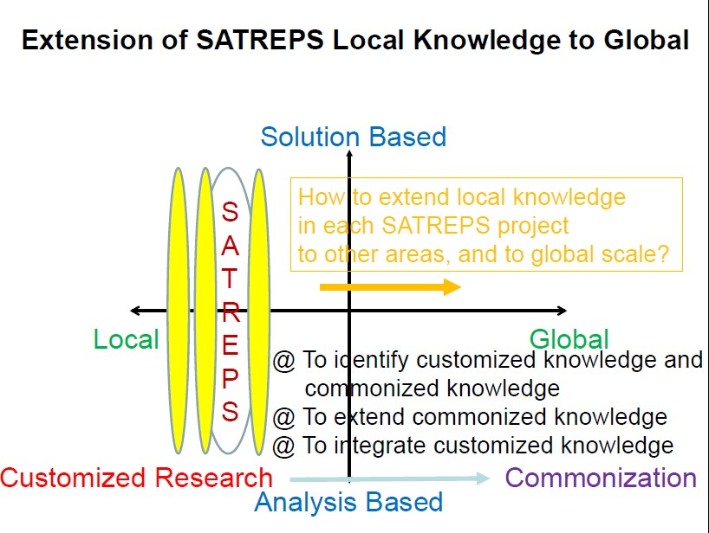
JST/JICA Joint Program : SATREPS
high-tech
medium-tech
low-tech and
local knowledge
Scale : Local – National – Regional - Global
By Dr.Yasuoka

Slide 26
5
A New Mode and Pathway of International Collaboration for SDGs & Pandemics
Academies;
ISC, Sci .Unions, NAS etc
United Nations and
UN agencies
International and Regional organizations
Development agencies
National governments
R&D funding agencies
Building dynamic partnership & networks
beyond boundaries
for SDGs & Pandemics
Local governments
Philanthropies
NGO’s, people, communities
Financial Sectors
Science Forum
Industrial sectors
Universities & Res. Labs.
〇 Science-Policy-Society interface, governance, evidence-based, multi-stakeholder engagement. 〇 Scale and Time : “Global–Regional–National–Local” *2021- 2025- 2030- post 2030.. 〇 What & How : Transformation of society, industry, education, STI system, life-style. (smart cities, disasters, aging & health, mobility, energy. efficiency and sufficiency. Individual & collective actions) 〇 Responsible R&I, trust, ethics and integrity, context and culture, open and data sharing,
Social science and humanities, trans-disciplinarity. 〇 STI for SDGs and SDGs for STI, Balancing basic research and innovation, Capacity building. | April 28, 2021, Tateo Arimot “SDGs and International Resea Collaboration”, at Nobel Prize Summit, | o, rch

Slide 27

Thank you very much for your attention
Tateo Arimoto
t-arimoto@grips.ac.jp arimoto@jst.go.jp http://www.jst.go.jp http://www.grips.ac.jp

Slide 28
Impact of Science
23-25 June, 2021
Sarah Foxen
Knowledge Exchange Lead at POST, UK Parliament, United Kingdom
#IOS21

Slide 29

Developing a Regional or National Impact Policy
Dr Sarah Foxen, Knowledge Exchange Lead Parliamentary Office of Science and
Technology, UK Parliament
AESIS Impact Of Science | 23rd June 2021

Slide 30


The Knowledge Exchange Unit
Vision: Our vision is to see strengthened parliamentary democracy through the use of diverse research evidence in parliamentary activity
Mission: Our mission is to enable and enhance UK Parliament to collaborate with the research community, to maximise each other’s impact

Slide 31

Defining impact
Photo by Nadir sYzYgY on Unsplash
31

Slide 32
Defining impact
A national impact framework needs to have a clear, simple, inclusive definition of impact, compatible with the definitions of others
Photo by Nadir sYzYgY on Unsplash
32

Slide 33

Understanding impact
5
Photo by Sonika Agarwal on Unsplash

Slide 34
Understanding impact
6
In a national impact framework there needs to be shared understanding between universities, research users and assessors of the different kinds of impact possible in different areas
Photo by Sonika Agarwal on Unsplash

Slide 35

Valuing impact
7
Image by Stefan Keller from Pixabay

Slide 36
Valuing impact
8
In a national impact framework, there needs to be discussion and shared understanding between universities, research users and assessors of the relative degrees of impact of different kinds of activity in different areas
Image by Stefan Keller from Pixabay

Slide 37

The boundaries of what counts as impact
Photo by Ross Findon on Unsplash

Slide 38
The boundaries of what counts as impact
In a national impact framework there needs to be shared understanding between universities, research users and assessors of where the boundaries of impact lie, and means to value diverse impacts
Photo by Ross Findon on Unsplash

Slide 39

The relationship between knowledge exchange and impact
Photo by Diego PH on Unsplash
39

Slide 40
The relationship between knowledge exchange and impact
A national impact framework needs to take into consideration the wider context in which it sits, and work in conjunction with a knowledge
exchange framework
Photo by Diego PH on Unsplash
40

Slide 41

The burden of capturing
and reporting impact
Image by Comfreak from Pixabay
41

Slide 42
The burden of capturing
and reporting impact
The burden of a national impact framework needs to be as light as possible, whilst ensuring the activity is robust, accurate and effective
Image by Comfreak from Pixabay
42

Slide 43

Negative impact of an impact
framework
Image by PublicDomainPictures from Pixabay

Slide 44
Negative impact of an impact
A national impact framework needs to be delivered in a way which minimises negative impact on those involved in it and supports them through it
framework
Image by PublicDomainPictures from Pixabay

Slide 45

Thank you
Houses of Parliament Westminster
SW1A 0AA
foxens@parliament.uk @SarahFoxen @UKParl_Research parliament.uk/research-impact

Slide 46
Impact of Science
23-25 June, 2021
Thank you
#IOS21

